Slide 1
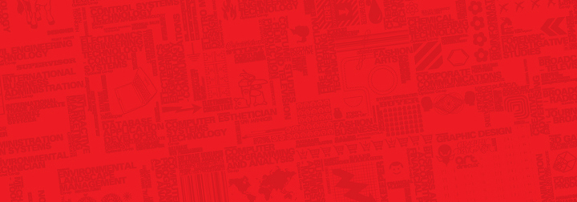
BTH645 - Multimedia Elements for User Interfaces
Shi, Yue (Sunny)
Office: DB2095
sunny.shi@senecacollege.ca
SENECA COLLEGE

Slide 2
Outline
Images
Two types of still images
(Bitmap & Vector)
Colors and palettes in multimedia
Image file types used in multimedia
Next week
audio
2

Slide 3
Two Types of Still Images
Bitmaps/ raster images
“Painting program”
Vector-drawn graphics
“Drawing program”

Slide 4
Bitmaps/ Raster images
A bitmap is a simple matrix or grid of dots and color information.
The smallest element of a bitmap is a pixel.
"put pixel of this color here";

Slide 5
Bitmaps/ Raster images
Bitmaps are an image format suited for creation of:
Photo-realistic images
Complex drawings
Images that require fine detail

Slide 6
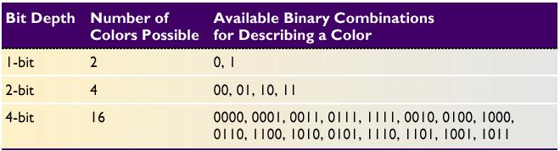
Bitmaps/ Raster images
Bitmapped images are known as paint graphics.
A bitmap is made up of individual dots or picture elements known as pixels or pels.
Bitmapped images can have varying bit and color depths.

Slide 7
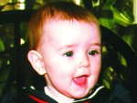

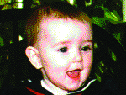
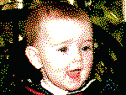
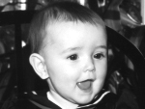

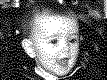
Bitmaps/ Raster images
24 bits depth.
Millions of colors.
Dithered to 8 bits.
Adaptive palette of 256 colors.
Dithered to 8 bits.
Macintosh palette of 256 colors.
Dithered to 4 bits.
16 colors.
Available binary Combinations for Describing a Color
Dithered to 8-bit gray-scale.
256 shades of gray.
Dithered to 4-bit gray-scale.
16 shades of gray.
Dithered to 1-bit.
Two colors, black and white.

Slide 8
Bitmaps/ Raster images
Bitmaps can be inserted by:
Using clip art galleries
Using bitmap software
Capturing and editing images
Scanning images

Slide 9
Bitmaps/ Raster images
Using clip art galleries
A clip art gallery is an assortment of graphics, photographs, sound, and video.
Clip art is a popular alternative for users who do not want to create their own images.

Slide 10
Bitmaps/ Raster images
Bitmap software
Windows:
Dedicated graphics programs such as Photoshop
Many multimedia authoring tools such as Director
Simple painting tools such as Microsoft Paint
Some office productivity software such as Word
Gimp,
Unix/ Linux:
Gimp (GNU Image Manipulation Program)
Dia: GTK+ based diagram creation program for GNU/Linux, MacOS X, Unix, and Windows

Slide 11
Bitmaps/ Raster images
Capturing images on screen
Macintosh, COMMAND-SHIFT-3, capture the entire screen
Macintosh, COMMAND-SHIFT-4, capture portion of screen.
Windows, PRINT SCREEN, copy screen to the clipboard.
Windows, snipping tool, capture portion of screen.
Windows, window+shift+A, capture portion of screen.
Screen capture software:
snagIt: http://www.techsmith.com/
screenHunter: http://www.wisdom-soft.com/products/screenhunter.htm
Snipping tool, Windows Vista and later

Slide 12
Bitmaps/ Raster images
Image editing programs enable the user to:
Enhance and make composite images.
Alter and distort images.
Add and delete elements.
Morph (manipulate still images to create animated transformations).

Slide 13
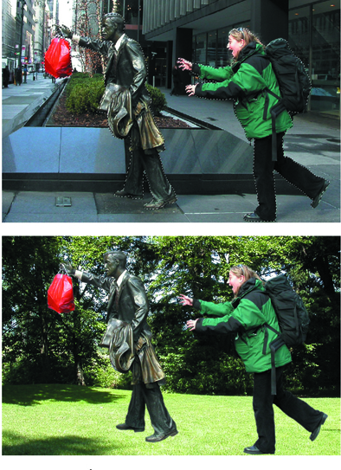
By graphic artist:
-- Frank Zurbano

Slide 14
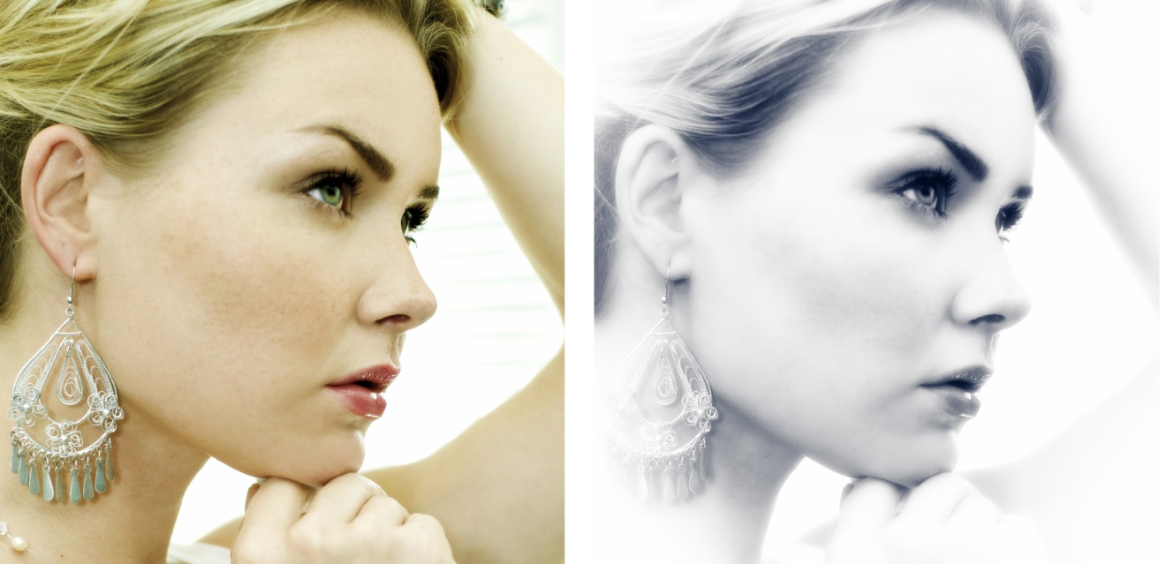
Bitmaps/ Raster images
scan images from conventional sources and make necessary alterations and manipulations.
Exposure from Alien Skin allows users to manipulate bitmapped images. Here a digital color image has been processed to look like it came from a darkroom.

Slide 15
Vector-drawn graphics
A vector is a line that is described by the location of its two endpoints.
Vector drawing makes use of Cartesian coordinates.
Cartesian coordinates are numbers that describe a point in two- or three-dimensional space as the intersection of the X, Y, and Z axes.
Vector graphics are described as mathematical formulas.
"draw line of this color from this relative coordinate to that relative coordinate".

Slide 16
Vector-drawn graphics
Vector-drawn images are used in the following areas:
Computer-aided design (CAD) programs
Graphic artists designing for the print media
3-D animation programs
Applications requiring drawing of graphic shapes
Cartoons, symbols, buttons, bitmapped text, abstract images, etc.

Slide 17
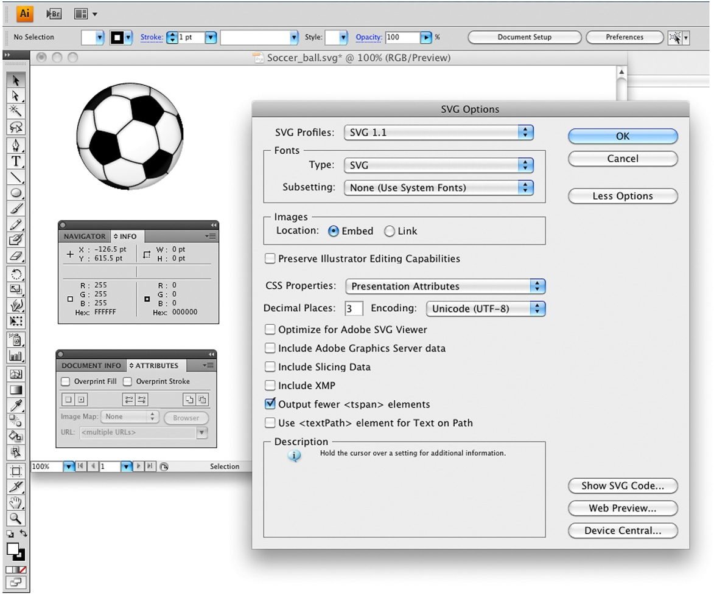
Vector-drawn graphics
Drawing software such as Adobe Illustrator can save vector graphics in SVG format.

Slide 18
Vector-based drawing programs
AutoCAD
Adobe’s Illustrator or InDesign
CorelDraw (styled CorelDRAW) is a vector graphics editor developed and marketed by Corel Corporation of Ottawa, Canada. - wiki

Slide 19
Vector-drawn graphics
What is SVG?
SVG stands for Scalable Vector Graphics
SVG is used to define vector-based graphics for the Web
SVG defines the graphics in XML format
SVG graphics do NOT lose any quality if they are zoomed or resized
Every element and every attribute in SVG files can be animated
Eg.

Slide 20
<!-- svg.html -->
<!DOCTYPE html>
<html>
<body>
<h3> Example of svg. </h3>
<svg width="400" height="180">
<rect x="50" y="20" width="150" height="150" style="fill:blue;stroke:pink;
stroke-width:5;fill-opacity:0.3;stroke-opacity:0.9"/>
Sorry, your browser does not support inline SVG.
</svg>
</body>
</html>

Slide 21
Vector-drawn graphics
SVG Advantages:
SVG images can be created and edited with any text editor
SVG images can be searched, indexed, scripted, and compressed
SVG images are scalable
SVG images can be printed with high quality at any resolution
SVG images are zoomable (and the image can be zoomed without degradation)

Slide 22

Some Terms
Raster graphics image, or bitmap, a dot matrix data structure representing a generally rectangular grid of pixels, or points of color, viewable via a monitor, paper, or other display medium. Raster images are stored in image files with varying formats. (http://en.wikipedia.org/wiki/Raster_image)

Slide 23
Some Terms
Vector graphics: use geometrical primitives such as points, lines, curves, and shapes or polygon(s), which are all based on mathematical expressions, to represent images in computer graphics.
Vector graphics are based on vectors (also called paths, or strokes) which lead through locations called control points.
Each of these points has a definite position on the x and y axes of the work plan. Each point, as well, is a variety of database, including the location of the point in the work space and the direction of the vector (which is what defines the direction of the track).
Each track can be assigned a color, a shape, a thickness and also a fill.
(http://en.wikipedia.org/wiki/Vector_graphics )

Slide 24
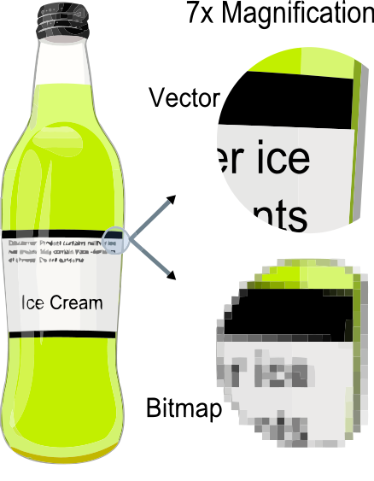
Image from: http://en.wikipedia.org/wiki/File:VectorBitmapExample.svg

Slide 25
Some Terms
Rasterisation (or rasterization): take an image described in a vector graphics format (shapes) and converting it into a raster image (pixels or dots) for output on a video display or printer or for storage in a bitmap file format.
Bitmaps can be converted to vector images using autotracing (difficult).

Slide 26
Vector-drawn images versus bitmaps
Vector images use less memory space and have a smaller file size as compared to bitmaps.
For the Web, pages that use vector graphics in plug-ins download faster and, when used for animation, draw faster than bitmaps.

Slide 27
Vector-drawn images versus bitmaps
Vector images cannot be used for photorealistic images.
Vector images may require a plug-in for Web-based display.
Bitmaps are not easily scalable and resizable.

Slide 28
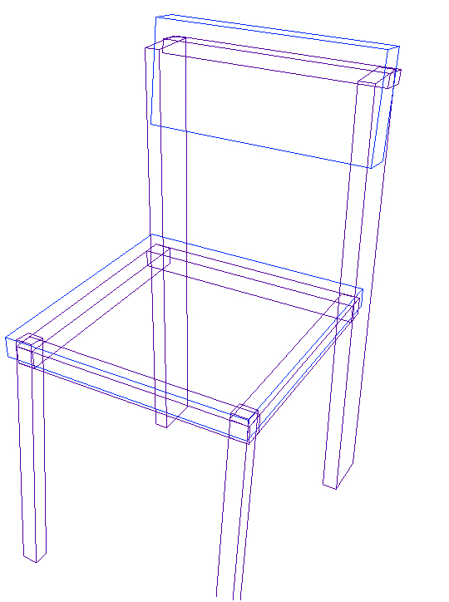
3-D Images
3-D drawing and rendering
3-D animation tools
Features of a 3-D application
Panoramas

Slide 29
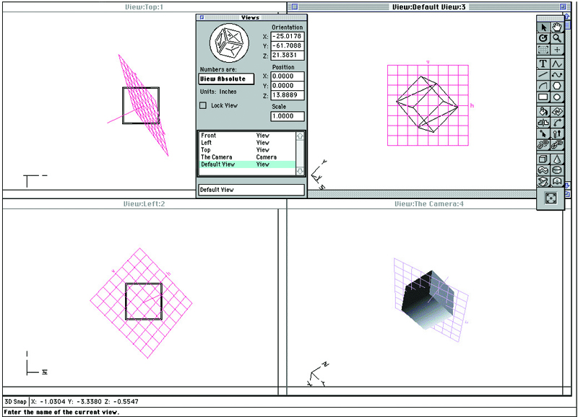
3-D Images
3-D animation, drawing, and rendering tools include:
Daz3D
Form*Z
NewTek′s Lightwave
Autodesk’s Maya
Google’s SketchUp
3-D applications provide x, y, and z axes and adjustable perspective views.

Slide 30
3-D Images
Features of a 3-D application
Modeling - Placing all the elements into 3-D space.
Extruding - The shape of a plane surface extends some distance.
Lathing - A profile of the shape is rotated around a defined axis.

Slide 31
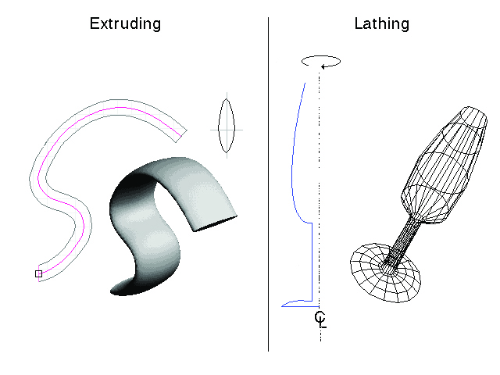
3-D Images

Slide 32
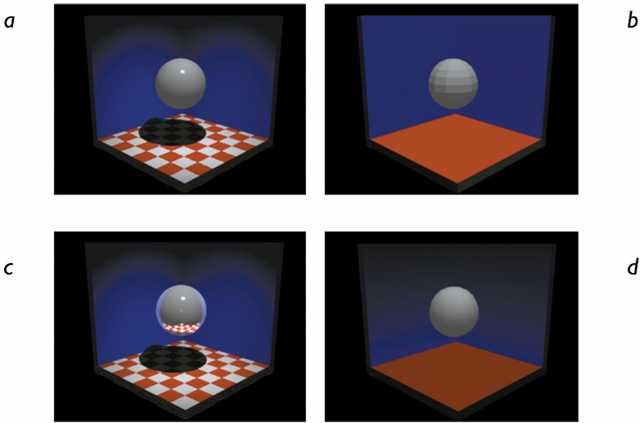
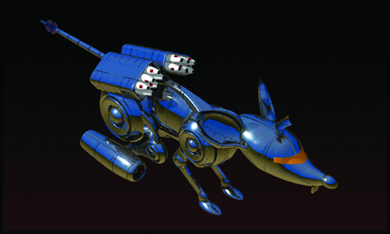
3-D Images
Rendering - Use of intricate algorithms to apply user-specified effects

Slide 33
Panoramas
Panoramic images are created by stitching together a sequence of photos around a circle and adjusting them into a single seamless bitmap.

Slide 34
Colors and Palettes in Multimedia
Models used to specify color in computer terms are:
RGB model – A 24-bit methodology: color is specified in terms of red, green, and blue values ranging from 0 to 255.
1 byte for red (8 bits)
1 byte for green (8 bits)
1 byte for blue (8 bits)
So, 24-bit (a.k.a. true) color
each pixel to be one of 2²⁴ (over 16 million) colors.

Slide 35
Colors and Palettes in Multimedia
Color palettes
Palettes are mathematical tables that define the color of pixels displayed on the screen.
Palettes are called “color lookup tables,” or CLUTs, on the Macintosh.
The most common palettes are 1, 4, 8, 16, and 24-bit deep.

Slide 36
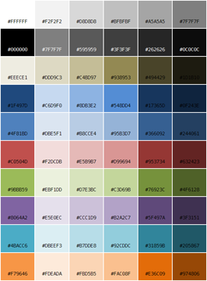
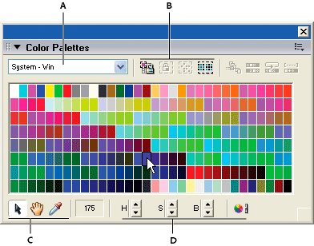

Slide 37
Colors and Palettes in Multimedia
Dithering:
Dithering is a process whereby the color value of each pixel is changed to the closest matching color value in the target palette.
This is done using a mathematical algorithm.

Slide 38
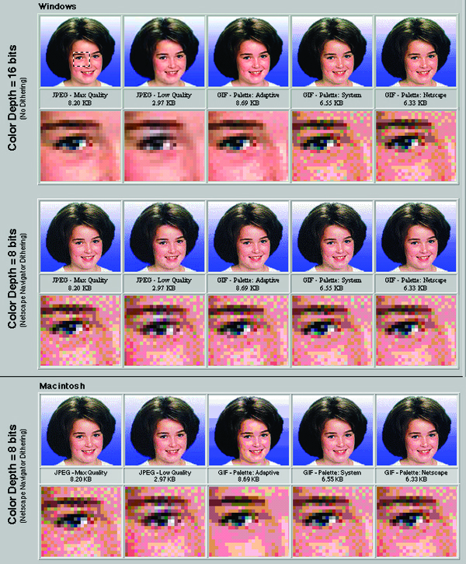
Colors and Palettes in Multimedia
Dithering
These images were dithered in Photoshop to best fit the 8-bit palettes of GIF files
Also shown are JPEG files compressed with highest and lowest quality and their actual file sizes.
Note the subtle differences among palettes and systems, especially in the gradient blue background.

Slide 39
Image File Types
Macintosh formats
On the Macintosh, the most commonly used format is PICT.
was developed by Apple Computer in 1984 as the native format for Macintosh graphics.
PICT is a complicated and versatile format developed by Apple.
Almost every image application on the Macintosh can import or export PICT files.
current operating system, Mac OS X, Apple has replaced PICT by PDF.

Slide 40
Image File Types
Windows formats
The most commonly used image file format on Windows is DIB, also known as BMP.
DIB stands for device-independent bitmaps.
Bitmap formats used most often by Windows developers are:
BMP - A Windows bitmap file
TIFF - Extensively used in DTP (Desktop Publishing) packages
PCX - Used by MS-DOS paint software

Slide 41
Image File Types
Cross-platform formats
JPEG, GIF, and PNG – Most commonly used format on the Web
Adobe PDF (Portable Document Format) – Manages multimedia content
PSD, AI, CDR, DXF – Proprietary formats used by applications
Initial Graphics Exchange Standard (IGS or IGES) – Standard for transferring CAD drawings

Slide 42
Uncompressed format – Raster Images /Bitmap
Uncompressed formats - .bmp, where the colour of every single pixel in the image is stored.
OK with small image, (e.g., 10000 pixels), but a typical resolution today is 1920x1080, which is 2073600 (over two million) pixels.
For practical use of large images compression is needed.

Slide 43
Image File Types – GIF/PNG
GIF: Graphics Interchange Format, bitmap image format
PNG: Portable Networks Graphics, raster graphics format, an improved, non-patented replacement for GIF
These formats provide lossless compression and are great for images with lots of solid colours, for example logos or diagrams or rasterized text.

Slide 44
Image File Types – GIF/PNG
The compression algorithm is more complicated than this, but can be understood as follows:
For each row
For each pixel
Record the colour of the pixel
Record the number of following pixels of the same colour
Skip the number of pixels of the same colour
E.g., if the picture contains an area of the same color, it can be compressed without loss by saying "200 red dots" instead of "red dot, red dot, ...(197 more times)..., red dot.“
Ineffective for images with lots of colour change, gradients, or shadows (for example photographs).

Slide 45
Image File Types – GIF/PNG
GIF is an old format, limitation of a 256 colour palette.
PNG is a newer format, with same benefits as GIF, but more flexibility.
PNG can have a paletted or grayscale or true colour PNG file.
drawbacks of PNG:
It does not support animation like GIF (it can, but only Firefox seems to support it, unlike GIF animation which is supported by every browser).
It has some support issues with older browsers like IE6.
Thirdly, important software like Photoshop have very poor implementation of the format.

Slide 46
Image File Types – JPEG
JPEG: Joint Photographic Experts Group, .jpg, .jpeg
This format provides lossy compression that is very good for images with lots of colour variation such as photographs.
You can compress a JPEG file more or less depending how high the quality is set to.
In a way this is similar to paletting where you drop the number of colours, but here the result is a choppier image for lower quality.

Slide 47
Lossy or lossless
In many cases it is advantageous to make a master lossless file that can then be used to produce compressed files for different purposes;
for example, a multi-megabyte file can be used at full size to produce a full-page advertisement in a glossy magazine, and a 10 kilobyte lossy copy can be made for a small image on a web page.

Slide 48
Lossy versus lossless
The advantage of lossy methods over lossless methods is that in some cases a lossy method can produce a much smaller compressed file than any lossless method, while still meeting the requirements of the application.
Lossy methods are most often used for compressing sound, images or videos.
human interpretation, the mind can easily "fill in the blanks" or see past very minor errors or inconsistencies – ideally lossy compression is transparent.

Slide 49
Transparency in Data Compression
Is the ideal result of lossy data compression.
If a lossy compressed result is perceptually indistinguishable from the uncompressed input, then the compression can be declared to be transparent.

Slide 50
Compression ratio
Compression ratio: the size of the compressed file compared to that of the uncompressed file.
Compression ratio for lossy video codecs is nearly always far superior to that of the audio and still-image equivalents.
Video can be compressed immensely (e.g. 100:1) with little visible quality loss
Audio can often be compressed at 10:1 with imperceptible loss of quality
Still images are often lossily compressed at 10:1, as with audio, but the quality loss is more noticeable, especially on closer inspection.

Slide 51
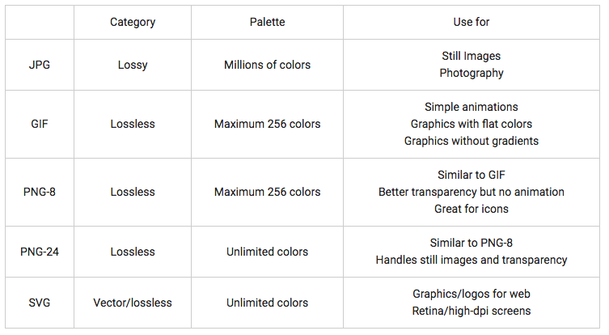
Convert Between Types
Reference: https://www.sitepoint.com/gif-png-jpg-which-one-to-use/

Slide 52
Next week
Audio

Slide 53
Thank you!

